Slide 1
MVRHS Athletic Fields DRI 352-M4
Land Use Planning Committee
Post-Hearing Review
June 7, 2021

Slide 2
MVRHS Athletic Fields (Phase 1)
Applicant: MV Public Schools
Designer: Huntress Associates Inc.
OPM: Daedalus Projects Inc.
Permits: Oak Bluffs Planning Board
Building permit
LUPC: 10/19/20, 11/16/20, 12/14/20
Hearing: 1/14/21, 2/4/21 (canceled), 2/18/21, 3/4/21, 3/18/21, 4/1/21, 4/15/21
Site visit: 2/2/21
Post-hearing LUPC: 6/7/21, (6/8/21, 6/15/21)

Slide 3
MVRHS Athletic Fields (Phase 1)
New 400-meter, eight-lane running track
One multi-purpose synthetic turf field with sports lighting and scoreboard
One renovated natural grass multi-purpose field
704-seat grandstand with pressbox
4,800 ft² fieldhouse (to be constructed later)
Reconfigured parking and pedestrian areas
Equipment storage shed and electrical utility building

Slide 4
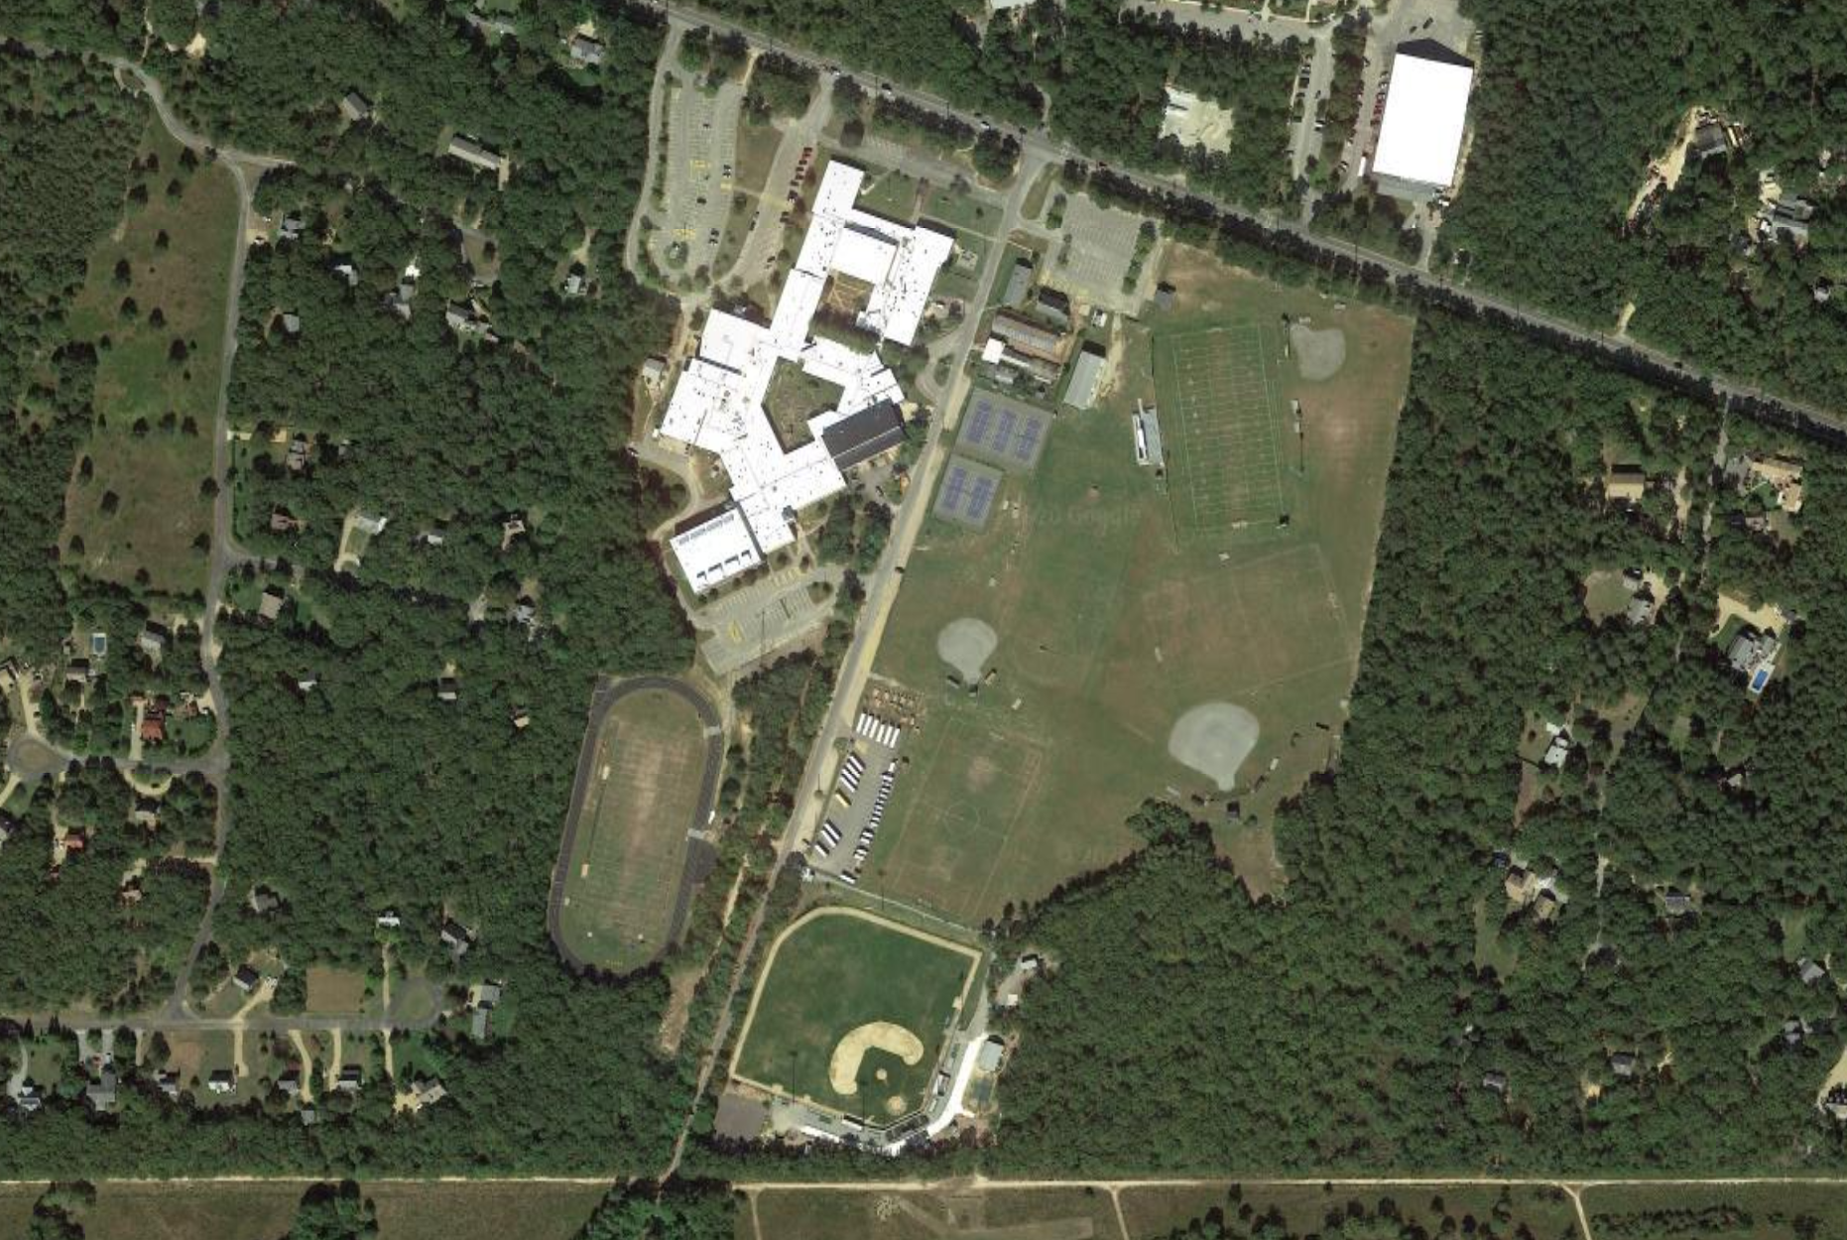

Slide 5
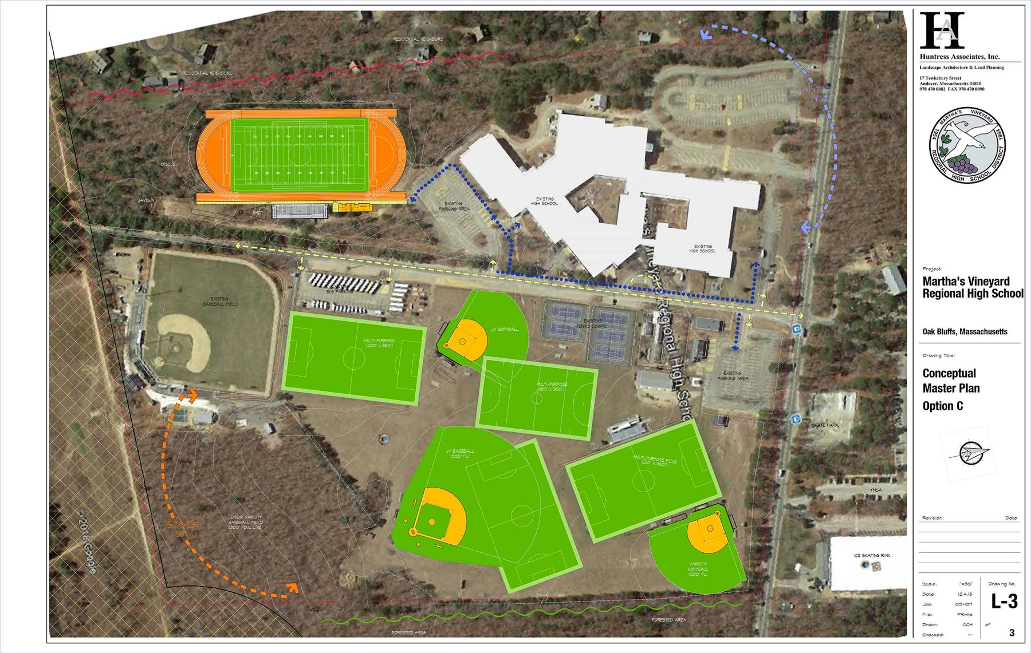

Slide 6
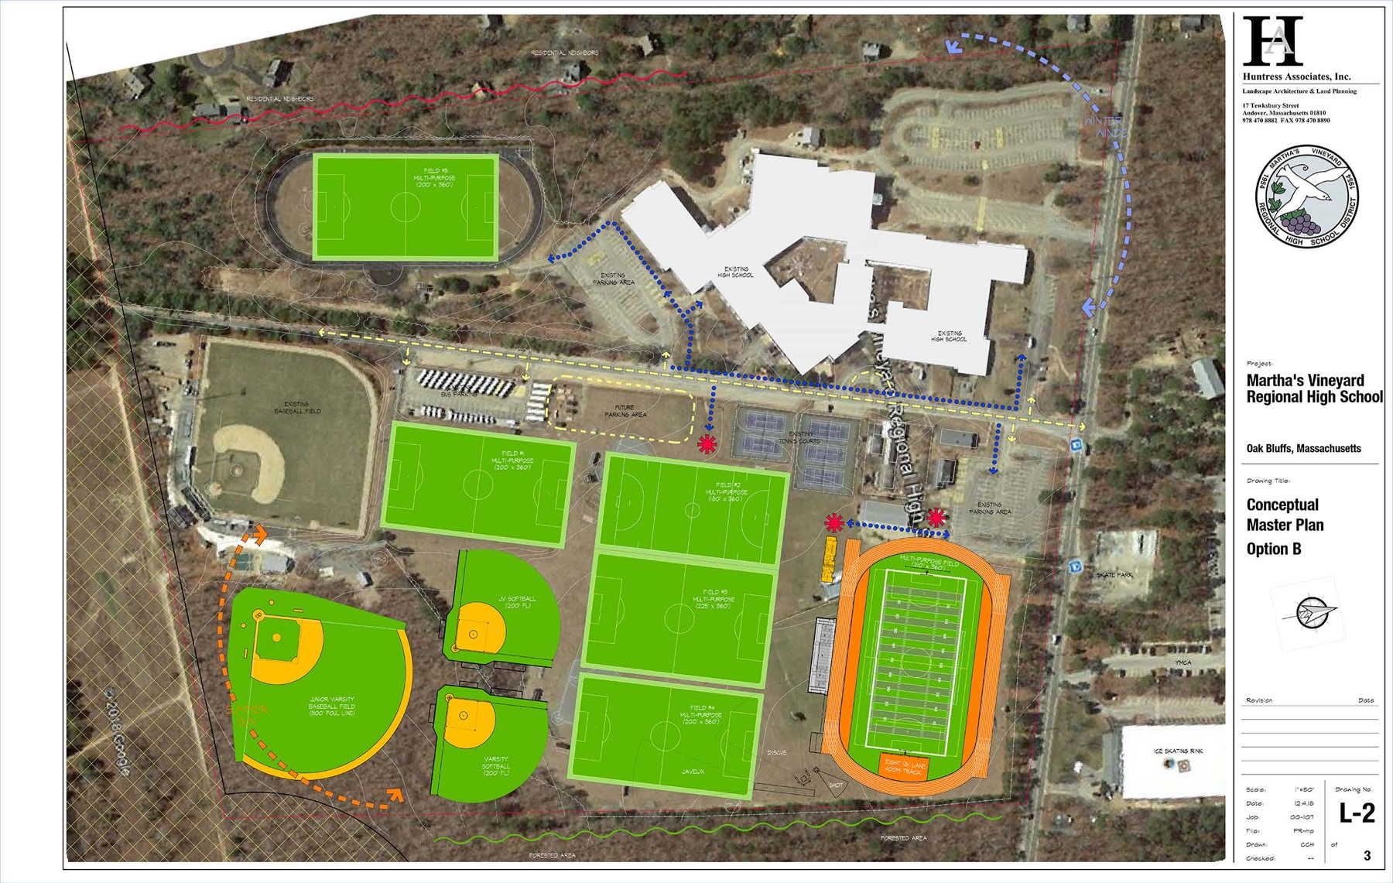

Slide 7
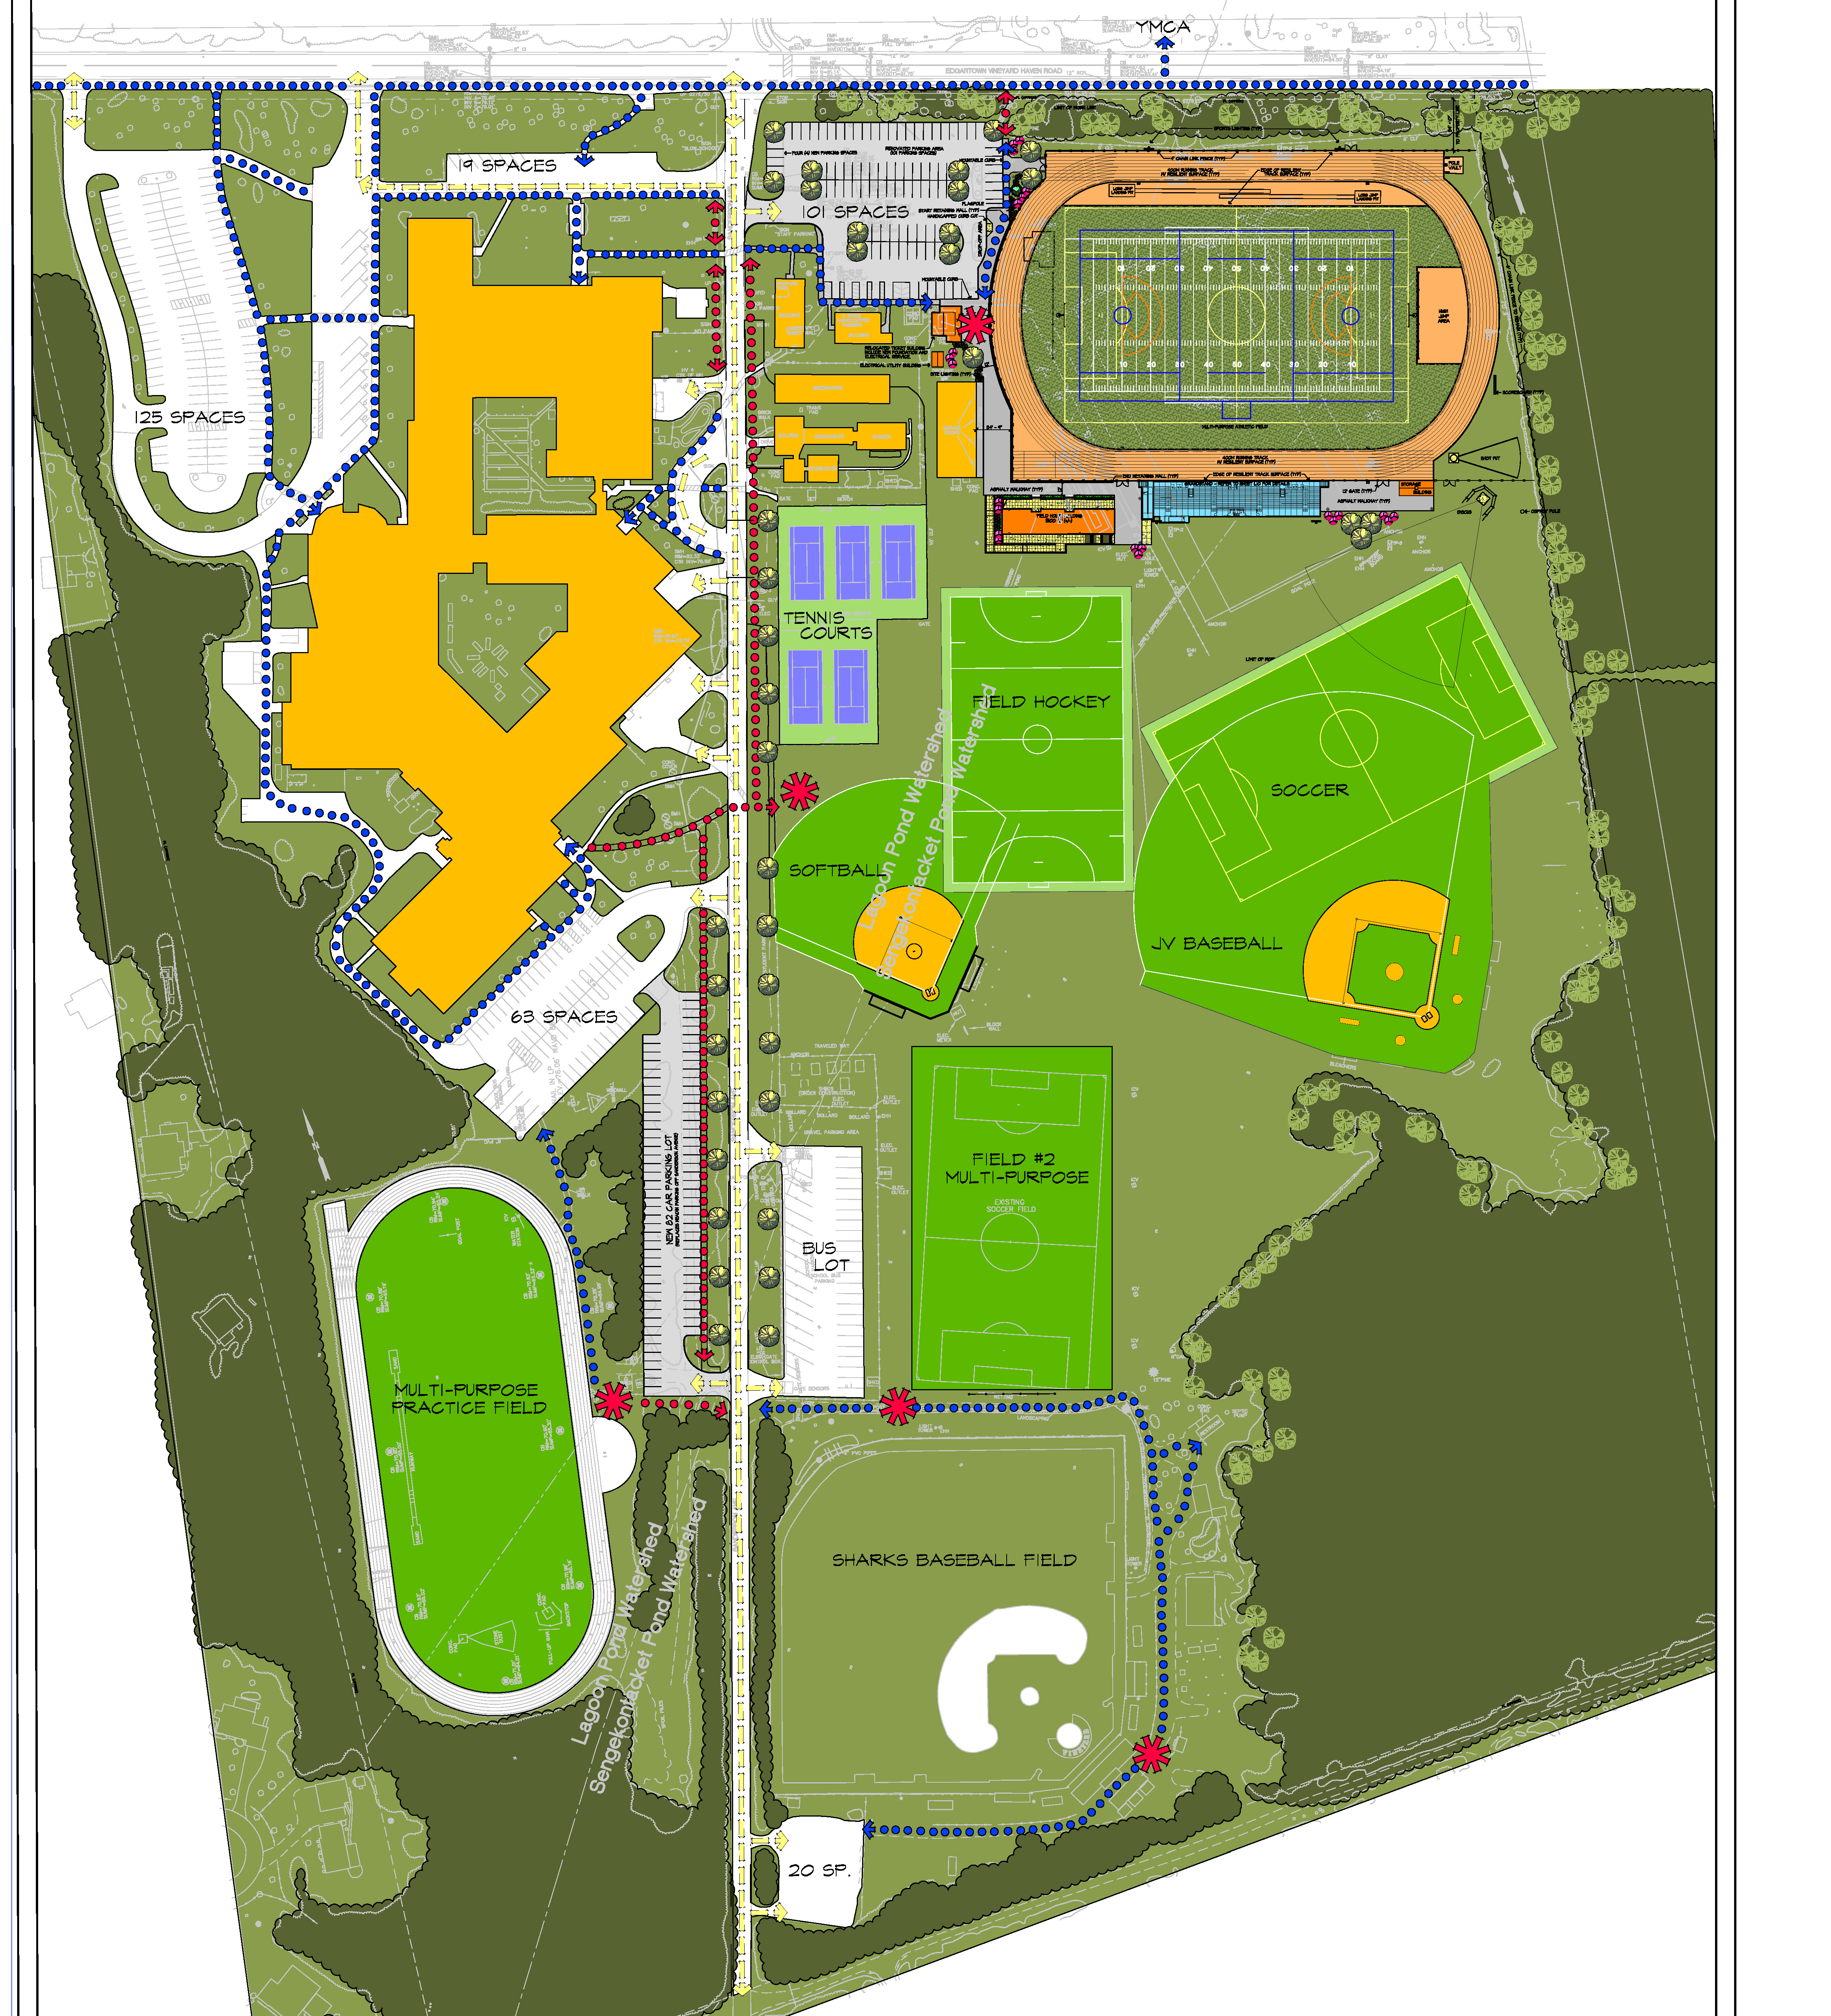

Slide 8
Project goals
Provide a new running track (top priority of high school)
Upgrade athletic field facilities for high school, youth sports, and summer camps (current and future users)
Improve circulation for traffic and pedestrians

Slide 9
Key documents and references
Usage considerations
Timing/phasing
Synthetic field installation and maintenance
Track installation and maintenance
Natural field installation and maintenance
Stormwater and drainage
Human health
Environmental health
Player safety
Recycling and disposal
Funding and warranties
Traffic and circulation
Landscape and lighting
Energy/climate
Educational opportunities
Discussion of alternatives

Slide 10
Usage considerations
Current usage estimates range from 2,900 hours per year (average of 580 hours per field) to 3,850 hours per year (average of 770 hours per field).
Proposed use of synthetic field: 1,800 hours/year.
Applicant has stated that the synthetic field would reduce use of remaining fields to 511 hours per year. (Earlier estimates projected that phase one using only natural grass would reduce the average usage to 583 hours per year.)
Natural turf playing fields in general can withstand up to around 600 hours of use per year, depending on maintenance; no rule of thumb.
Applicant has stated that the fields at MVRHS could withstand up to 425 hour of use per year.

Slide 11
Usage considerations
Provided by staff or applicant:
Applicant’s field use analysis (July 15, 2020)
Field use diagrams (existing and proposed)
Original use estimates (Athletic Fields Master Plan): Pages 14-15
Maximum use recommendations for natural fields (various sources): Staff Report, page 7
STMA email regarding maximum field usage
Horsley Witten Case Study
Applicant response to Marblehead Case Study by TURI
Q&A Documents:
May 26, 2020 Q&A: Questions 17 and 18
Nov. 13, 2020 Q&A: Question 4
Dec. 1, 2020 Q&A: Questions 5-7
Dec. 28 Q&A: Questions 1, 22
Jan. 25, 2021 Q&A: Question 3 and attachment from Jan. 27
Selected correspondence/testimony:
Richard Bennet letter 3/4/20
Derek Norcross letter 12/17/20
Martha’s Vineyard Youth Lacrosse 1/7/21
TURI letter regarding Marblehead Case Study 1/8/21
Richard Bennett letter 1/14/21
Donald Herman 2/8/21
Field Fund testimony 2/18/21
Mark McCarthy presentation 4/13/21
John Wilson presentation 3/18/21

Slide 12
Timing/phasing
First phase of multi-phase project to reorganize and upgrade the playing field facilities.
Fieldhouse would not be constructed until it can connect to a wastewater facility (final plans subject to MVC review).
Applicant would return within 2 years of completion of phase 1 with a plan to upgrade and maintain the remaining grass fields, and to remove the existing track
Final construction schedule and management plan to be submitted to LUPC

Slide 13
Timing/phasing
Provided by staff or applicant:
Athletic Fields Master Plan
Plan set part 1
Plan set part 2
Offers 10.1, 10.2, 10.3
Q&A documents:
April 3, 2020 Q&A: Question 2
Dec. 1, 2020 Q&A: Questions 1, 4, 18, 19
Dec. 28, 2020 Q&A: Question 9, 19, 21
March 17, 2021 Q&A: Question 3

Slide 14
Synthetic field installation and maintenance
One 105,000 ft² synthetic field; plans/specs provided for the foundation, drainage, shockpad, carpet, and infill.
Will include 2 groundwater monitoring wells (north of the field) and 2 ports for stormwater sampling.
Draft annual maintenance plan provided. (A two-year maintenance package will be included in the project specifications.)
Purchase of the synthetic field would include a field groomer and field sweeper to keep the surface consistent.
No additional synthetic fields (except for replacements of Field 1) without MVC approval.
Will include filter fabric backing and trench drains to help capture microplastics.
MVRHS to employ a full-time, year-round qualified sports turf manager.
At least annual G-Max and HIC testing.
No biocides of any sort to be applied.

Slide 15
Synthetic field installation and maintenance
Provided by staff or applicant:
Plan set part 1
Plan set part 2
Proposed synthetic field maintenance program
Offers 2.1, 2.2, 2.3, 3.2, 3.3, 3.4
Q&A documents:
Nov. 13, 2020 Q&A: Questions 7, 9, 11, 12, 14, 17-20
Dec. 12, 2020 Q&A: Questions 2, 9, 12, 16, 17
March 16, 2020 Q&A: Questions 3, 6, 7

Slide 16
Track installation and maintenance
One 400-meter track around the game field, expected to last about 24 years.
Proposed Rekortan G13 product would include SBR as an encapsulated base layer and EPDM as a top layer bound in place (minimizes SBR crumb rubber); final specs for surfacing material, including end of life requirements, to be submitted to LUPC.

Slide 17
Track installation and maintenance
Provided by staff or applicant:
Plan set part 1
Plan set part 2
Track product info
Track surface scope and specs
Other locations of the proposed track product
Material Safety Data Sheet – track surface (part A)
Material Safety Data Sheet – track surface (part B)
Offer 5.8
Q&A documents:
Nov. 16, 2020 Q&A: Question 4

Slide 18
Natural field installation and maintenance
One 75,600 ft² natural field (upgrade to existing), with drainage system and irrigation.
Draft annual maintenance plan for Field 2 provided, including fertilization program to comply with DCPC.
School currently spends about $150,000/year on field maintenance, including contractors and staff labor.
Final drainage and irrigation plan to be submitted to LUPC.
Final construction plans and annual maintenance plan to be reviewed by a third-party qualified natural sports turf professional prior to construction (section subject to MVC approval)
Nutrient Management Plan to be developed by a practicing turfgrass agronomist and/or Certified Nutrient Planner.
No biocides of any sort applied to the field.

Slide 19
Natural field installation and maintenance
Provided by staff or applicant:
Estimate of probable long-term costs
Draft annual maintenance plan and fertilization program
Information about existing sprinkler heads
Follow-up email from Richie Smith regarding maintenance
STMA info sheet
Strategies for Managing Heavily Used Fields (STMA)
Offers 2.4, 3.1, 3.4
Q&A documents:
Dec. 12, 2020 Q&A: Questions 1 and 3
Nov. 13, 2020 Q&A: Question 13, 20, 21
Selected correspondence/testimony:
Natural Grass Advisory Group – Review of Documents and Design
John Wilson 3/18/21
Noli Taylor 4/1/21
Donald Herman 4/15/21
Rachel Massey (TURI) 5/3/21

Slide 20
Stormwater and drainage
Stormwater report provided (revised based on Horsley Witten comments). Both fields will have drainage systems.
About 79,500 square feet of new impervious surfaces, will include a series of stone trenches, catch basins, and underground filtration chambers. A drainage system beneath the synthetic field is expected to last 30-40 years.
Synthetic field will have stormwater sampling ports (final monitoring plan to be submitted to LUPC)
Final drainage designs for both fields to be submitted to LUPC
Rain gardens to help filter nitrogen from parking area. (Final details submitted to LUPC.)
Applicant will investigate further options for rainwater harvesting onsite, including storage of runoff for non-potable use.

Slide 21
Stormwater and drainage
Provided by staff or applicant:
Grading and drainage plan
Stormwater Report
Horsley Witten Environmental Review
Horsley Witten Environmental Review (final comments to Huntress)
Offers 4.1-4.4

Slide 22
Human health and safety
Toxicology peer review found de minimis risk associated with direct contact, although impact of leaching over time is uncertain.
Spot cleaning with water and alcohol as needed.
Carpet and infill have passed federal or international fire safety standards; former interim Oak Bluffs Fire Chief has stated the project will likely not lead to an increase in fire safety or life safety issues.
New facilities will be ADA-compliant.
2 groundwater monitoring wells to be installed north of Field 1, with annual inspection, sampling, and analysis. (Reports submitted to MVC and OB Board of Health annually.)
Baseline groundwater sampling to be done prior to construction.
Heat Modification Policy to be submitted to LUPC.
Proposed track will reduce use of SBR crumb rubber.

Slide 23
Human health
Provided by staff or applicant:
Synthetic field disinfection plan and manufacturer response
STMA recommendations regarding disinfection
CDC guidelines for cleaning
Fire testing results for infill and carpet
Material Safety Data Sheet: carpet
Material Safety Data Sheet: infill
Material Safety Data Sheet: shockpad
The Influence of Soil on Immune Health (article)
Synthetic Turf Laboratory Testing and Analysis Summary Report (Tetra Tech)
Synthetic Turf Laboratory Testing and Analysis Summary Report (Horsley Witten)
Offers 5.1, 5.2, 5.8
Q&A documents:
Dec. 1, 2020 Q&A: Questions 8-11
Selected correspondence/testimony:
Laura Green presentation 1/12/21
Fire Emergency Coalition 3/3/21
Kristin Mello testimony 3/4/21
Oak Bluffs interim fire chief statement 3/31/21
Jeff Gearhart presentation 4/1/21

Slide 24
Environment
Concerns focus on microplastics and other potential contaminants, and recycling/disposal.
Horsley Witten determined that there was insufficient data to definitively conclude how the carpet, shock pad, and infill would affect the environment.
Project as proposed would reduce nitrogen loading in the Sengekontacket and Lagoon watersheds.
Spot cleaning with water and alcohol as needed.
Filter fabric and trench drains for Field 1 to help capture microplastics.
Future phases would require clearing of habitat.
2 groundwater monitoring wells to be installed north of Field 1, with annual inspection, sampling, and analysis. (Reports submitted to MVC and OB Board of Health annually.)
Stormwater sampling ports to help monitor nitrogen.
Baseline groundwater sampling to be done prior to construction.
Microplastic Reduction Action Plan to be submitted to LUPC.
Long-term Plastic Use Reduction Plan for high school to be submitted to LUPC.
Proposed track will reduce use of SBR crumb rubber.
(See also Recycling and Disposal.)

Slide 25
Environmental health
Provided by staff or applicant:
Horsley Witten Environmental Performance Review
Horsley Witten Environmental review – final comments to Huntress
Information about proposed trench drains
Proposed groundwater monitoring wells
Offers 5.1-5.8
Q&A documents:
April 3, 2020 Q&A: Question 11
May 26, 2020 Q&A: Question 13-16
Dec. 1, 2020 Q&A: Questions 16
Dec. 12, 2020 Q&A: Questions 10, 11, 24
Dec. 28, 2020 Q&A: Questions 2, 3, 7, 11
Feb. 17, 2021 Q&A: Question 4
March 16, 2021 Q&A: Question 1
Selected correspondence/testimony:
Island Grown Initiative 7/28/20
Jeremy Houser and Brendan O’Neill (VCS) 10/19/20
Mass Audubon 10/19/20
First Congregational Church Green Team 1/8/21
West Tisbury Energy Committee 1/11/21
Ewart, Sweeney, and Tilton 1/12/21
Vineyard Conservation Society 1/12/21
Tisbury Waterways Inc. Board of Directors 1/13/21
MV Shellfish Group 1/17/21
Mill Brook Watershed Management Committee 1/19/21
We Stand Together 1/23/21
Aquinnah Climate and Energy Committee 2/1/21
West Tisbury Conservation Commission 2/1/21
Chilmark Energy Committee 2/2/21
Sara-Jeanne Royer 2/2/21
Lagoon Pond Association 2/4/21
MV Environmental Educators Alliance 2/17/21
Amanda Farber 3/16/21
Sara-Jeanne Royer 3/16/21
350MV 4/15/21

Slide 26
Player safety
Focuses on firmness, temperature, friction.
Heat Modification Policy to be submitted to LUPC.
Proposed track will reduce use of SBR crumb rubber.

Slide 27
Player safety
Provided by staff or applicant:
Warranty info, including G-Max ratings
A Guide to Synthetic and Natural Turfgrass for Sports Fields (STMA)
Horsley Witten Case Study (page 8)
Human Health Issues on Synthetic Turf in the USA (paper)
Synthetic Turf Heat Evaluation – Progress Report (Penn State Center for Sports Surface Research)
FIFA test results (see attachment)
Brockfill heat information
Offer 5.6
Q&A documents:
May 26, 2020 Q&A: Questions 24-28
Nov. 13, 2020 Q&A: Questions 14, 20
Dec. 17, 2020 Q&A: Question 7
Dec. 28, 2020 Q&A: Questions 6, 29
Jan. 25, 2021 Q&A: Questions 17, 19
April 13, 2021 Q&A: Questions 1, 2
Selected correspondence/testimony:
Tania Laslovich 2/10/21
David Halsey Presentation 3/18/21
Tania Laslovich presentation 3/18/21

Slide 28
Recycling and disposal
No recycling facilities currently operating in the US; one in Denmark.
Guarantees by manufacturer that the field will be recycled.
Shockpad is intended to be recycled at end of life.
$50,000 escrow account for end of life.
No alternatives analysis provided.
Cost estimates for disposal vary widely ($35,000-$191,000)
Applicant has offered to recycle the synthetic field at its end of life, in the nearest facility available at the time, with chain of custody, and cost covered by the manufacturer.
Cost of recycling future fields also covered by manufacturer.

Slide 29
Recycling and disposal
Provided by staff or applicant:
Letters from Greenfields president regarding synthetic turf recycling
Email from GBN AGR (Netherlands) regarding synthetic turf recycling
Huntress pay certificate from previous work
TURI Sports Turf Alternatives Assessment
Sample end-of-life assessment
Brock recovery and reuse guarantee
Huntress response to Amanda Farber letter
Assessment of Cradle-to-Cradle Certified Products program (paper)
TURI emails regarding synthetic turf recycling
Offers 6.1 and 6.2
Q&A documents:
Nov. 13, 2020 Q&A: Question 15
Dec. 1, 2020 Q&A: Question 17
Dec. 12, 2020 Q&A: Questions 8, 9, 25, 28
Dec. 28, 2020 Q&A: Questions 20, 23
Jan. 25, 2021 Q&A: Questions 13-15
Selected correspondence/testimony:
Amanda Farber 10/9/20
Amanda Farber 12/1/20
Eric Hughes 3/18/21

Slide 30
Funding and warranties
Phase 1 estimated at about $7.7 million, not including replacement, maintenance, etc. (includes $985,000 for synthetic field installation and $250,00 for natural field renovation).
20-year costs for the 2 fields, including installation, replacement, recycling, renovation, and maintenance are about $1.7 million for synthetic field and $902,000 for natural field ($2.6 million total).
Applicant has stated that because the project is privately funded, it will not affect financial planning for the new school building.
High school also does not anticipate instituting user fees for the new facilities, except for community organizations, as is already the case.
All capital costs for phase 1 to be covered by donations.
Replacements of the field will be covered by donations, in perpetuity.
Final warranty specs for the synthetic products, including any exclusions, to be submitted to LUPC.

Slide 31
Funding and warranties
Provided by staff or applicant:
Athletic Fields Master Plan
Current user fees
TURI Sports Turf Alternatives Assessment
STMA estimated costs (natural and synthetic)
Synthetic turf warranty information
Cost estimate comparison table
Offers 1.1-1.3
Q&A documents:
Dec. 1, 2020 Q&A: Questions 1-4, 12, 13, 17
Dec. 28, 2020 Q&A: Questions 14, 15, 24

Slide 32
Traffic and circulation
Plans submitted for pedestrian corridor along Sanderson Ave, including new parking lot to replace parking along the road (same number of parking spots), and for crossing infrastructure on Edgartown-VH Road.
Improvements to parking area near game field (101 spots).
MVRHS does not expect phase one of the athletic fields project to increase vehicle trips to and from the school, and the seating capacity at the primary game field will decrease from about 800 to 704 seats.
Final traffic and pedestrian circulation plan to be submitted to LUPC.

Slide 33
Traffic and circulation
Provided by staff or applicant:
Plan set (sheet L-1)
Campus circulation plan
Traffic crossing signal plan
Oak Bluffs High School Pedestrian Crossing Safety Improvements (2019 Howard Stein Hudson memo)
Turning count summary (Sanderson/Edgartown-VH Road)
Offer 7.1
Q&A documents:
April 3, 2020 Q&A: Questions 15, 16
May 26, 2020 Q&A: Question 4
Dec. 12 Q&A Question 13

Slide 34
Landscape and lighting
Landscape and lighting plans provided. (Landscape plan showcases native species.)
Small amount of lighting would spill onto Edgartown-VH Road.
Complete plan set (including landscaping and lighting) to be submitted to LUPC.
All sports and site lighting to be dark-sky compliant. Sports lighting will also comply with Community Friendly Sports Lighting Program.
All lighting except for security to be turned off at night (hours provided).

Slide 35
Landscape and lighting
Provided by staff or applicant:
Landscape plan
Lighting plans
Offers 8.1-8.3

Slide 36
Energy/climate
Relates to buildings, fields, lighting, vehicles.
Buildings will be all-electric.
Synthetic turf has a larger footprint than natural turf.
Proposed sports lighting is LED with 25-year warranty, may reduce carbon emissions by 98 tons over 25 years.
Recycling of synthetic field, including shipping overseas, would likely be energy intensive.
Applicant will provide a plan for electric bus charging stations to LUPC with 2 years of completion.
Fieldhouse will have rooftop solar panels.

Slide 37
Energy/climate
Provided by staff or applicant:
25-year cost comparison (Musco lighting; see attachment)
How Sports Turf Helps Reduce the Carbon Footprint (article)
Technical Assessment of the Carbon Sequestration Potential of Managed Turfgrass in the United States (report)
Offers 9.1-9.4
Q&A documents:
Dec. 28, 2020 Q&A: Question 30

Slide 38
Educational opportunities
MVRHS will utilize rainwater sampling ports, rain gardens, monitoring wells, and other features in its science programs, and the natural grass maintenance in its Horticulture Program.

Slide 39
Educational opportunities
Provided by staff or applicant:
Offers 11.1 and 11.2
Q&A documents:
Dec 12, 2020 Q&A: Questions 7, 22

Slide 40
Discussion of alternatives
High school already has a playing field campus that serves students and other Island groups, and is located near other community organizations
Current usage estimates range from 2,900 hours per year (average of 580 hours per field) to 3,850 hours per year (average of 770 hours per field).
Applicant has stated that the synthetic field (1,800 annual use) would reduce use of remaining fields to 511 hours per year.
Natural turf playing fields in general can withstand up to around 600 hours of use per year, depending on maintenance, although there is no rule of thumb. The applicant has stated that the fields at MVRHS could withstand up to 425 hour of use per year.
Alternatives to the synthetic field, as proposed by the applicant, would involve creating two additional natural fields that may impinge on nearby residential areas.
Applicant has stated that increased usage is not possible without a synthetic field.
Natural turf experts have provided opinions that with proper maintenance the current usage could be maintained using only natural turf.

Slide 41
Discussion of alternatives
Provided by staff or applicant:
Athletic Fields Master Plan
Q&A documents:
Nov. 16, 2020 Q&A: Questions 5, 10
March 16, 2020 Q&A: Questions 4 and 9
March 17, 2021 Q&A: Question 3
Selected correspondence/testimony:
Deer Run Association 2/1/21
Deer Run Executive Board 3/21/21
Patrick and Polly Toomey 4/1/21

